Slide 1
SAP ABAP FINAL PROJECT
B.SAHITHIVISHNU
G2 SAP ABAP

Slide 2
Overview
Database Tables & TMG
Employee Table
Student Table
Interactive Report (Designation/Division)
ALV Report with Excel Download Button
Smart Forms
Employee smart form
Student smart form
Module Pool Program
For employee data
For student data

Slide 3
Project 1: Database Tables
Objective: Create 2 custom tables for Employee & Student
Steps:
Create data elements and data types for fields in SE11
Create tables in SE11
Fields: Emp ID, Name, Designation, Salary (Employee); Stu ID, Name, roll, div (Student)
Activate the database tables
Generate Table Maintenance Generator (SM30)
Enter dummy records

Slide 4
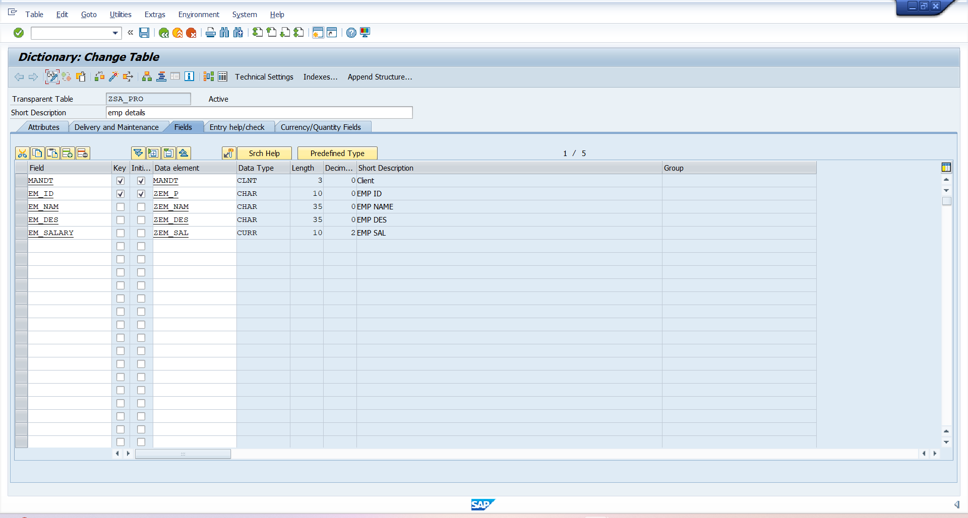
OUTPUT- Employee Table

Slide 5
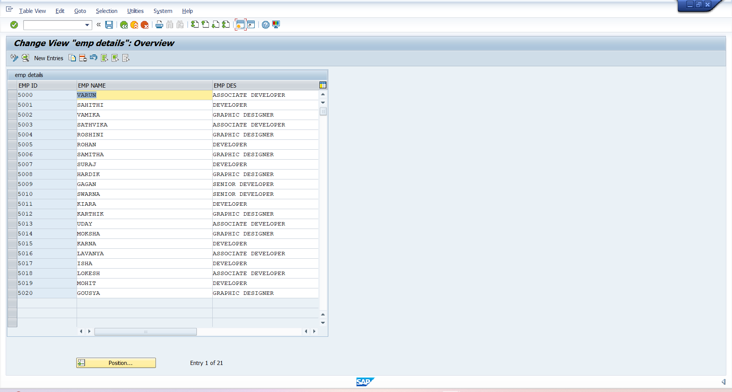
Employee Table Data

Slide 6
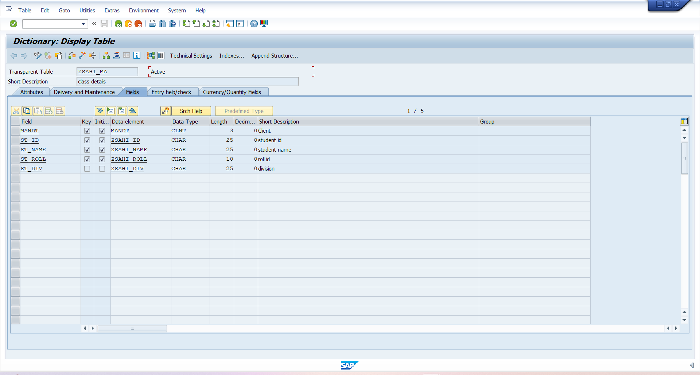
OUTPUT- Student Table

Slide 7
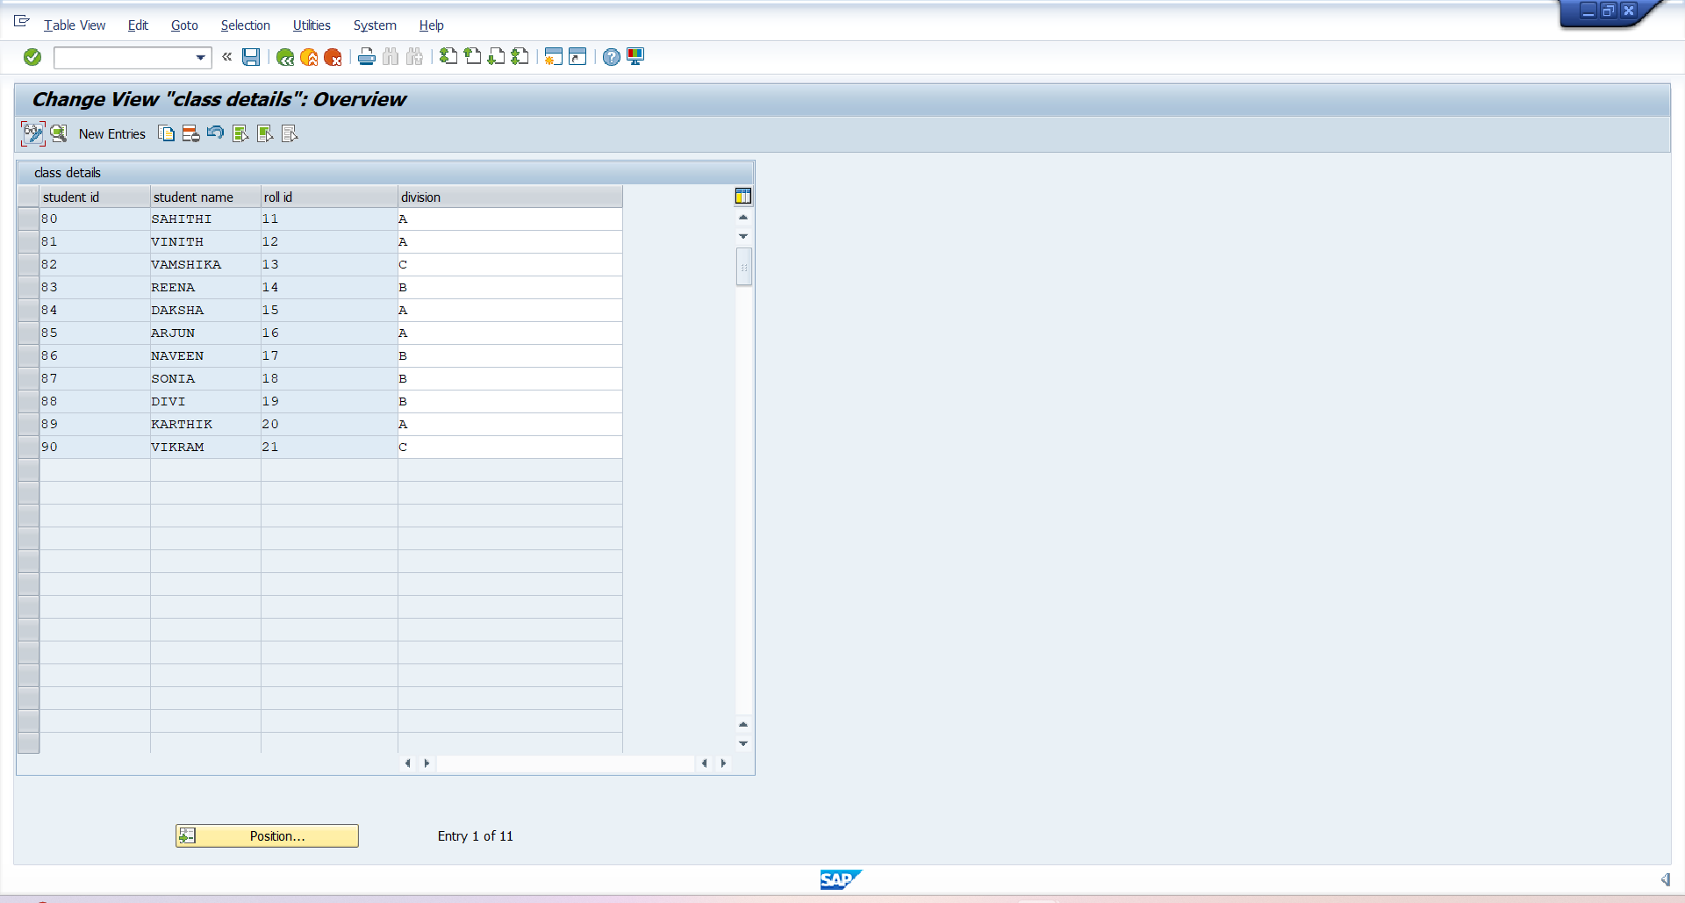
Student Table Data

Slide 8
Project 2: Interactive Report
Objective
Create an interactive ABAP report
Radio button selection decides Employee Report or Student Report.
In Employee Report → click on Designation to see all employees with that designation.
In Student Report → click on Division to see all students in that division.
Steps
Create Employee and student tables.
Define structures , internal tables and work areas for Tables.
Create radio buttons for division and designation.

Slide 9
Technique
Implemented Classical Interactive Report
Used:
WRITE ... HOTSPOT ON → Makes Designation/Division clickable
AT LINE-SELECTION → Captures user click
GET CURSOR FIELD VALUE → Retrieves clicked field value
Drilldown logic in PERFORM routines

Slide 10
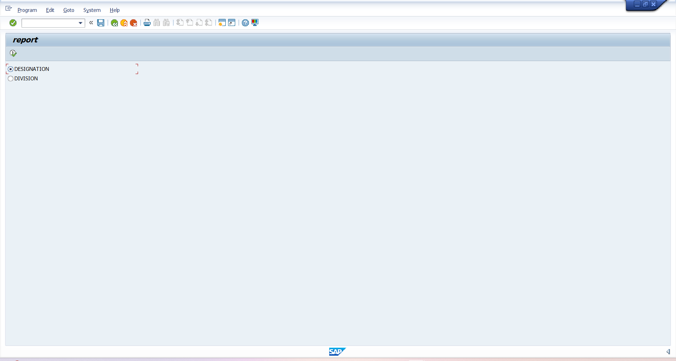
Output-Employee data

Slide 11
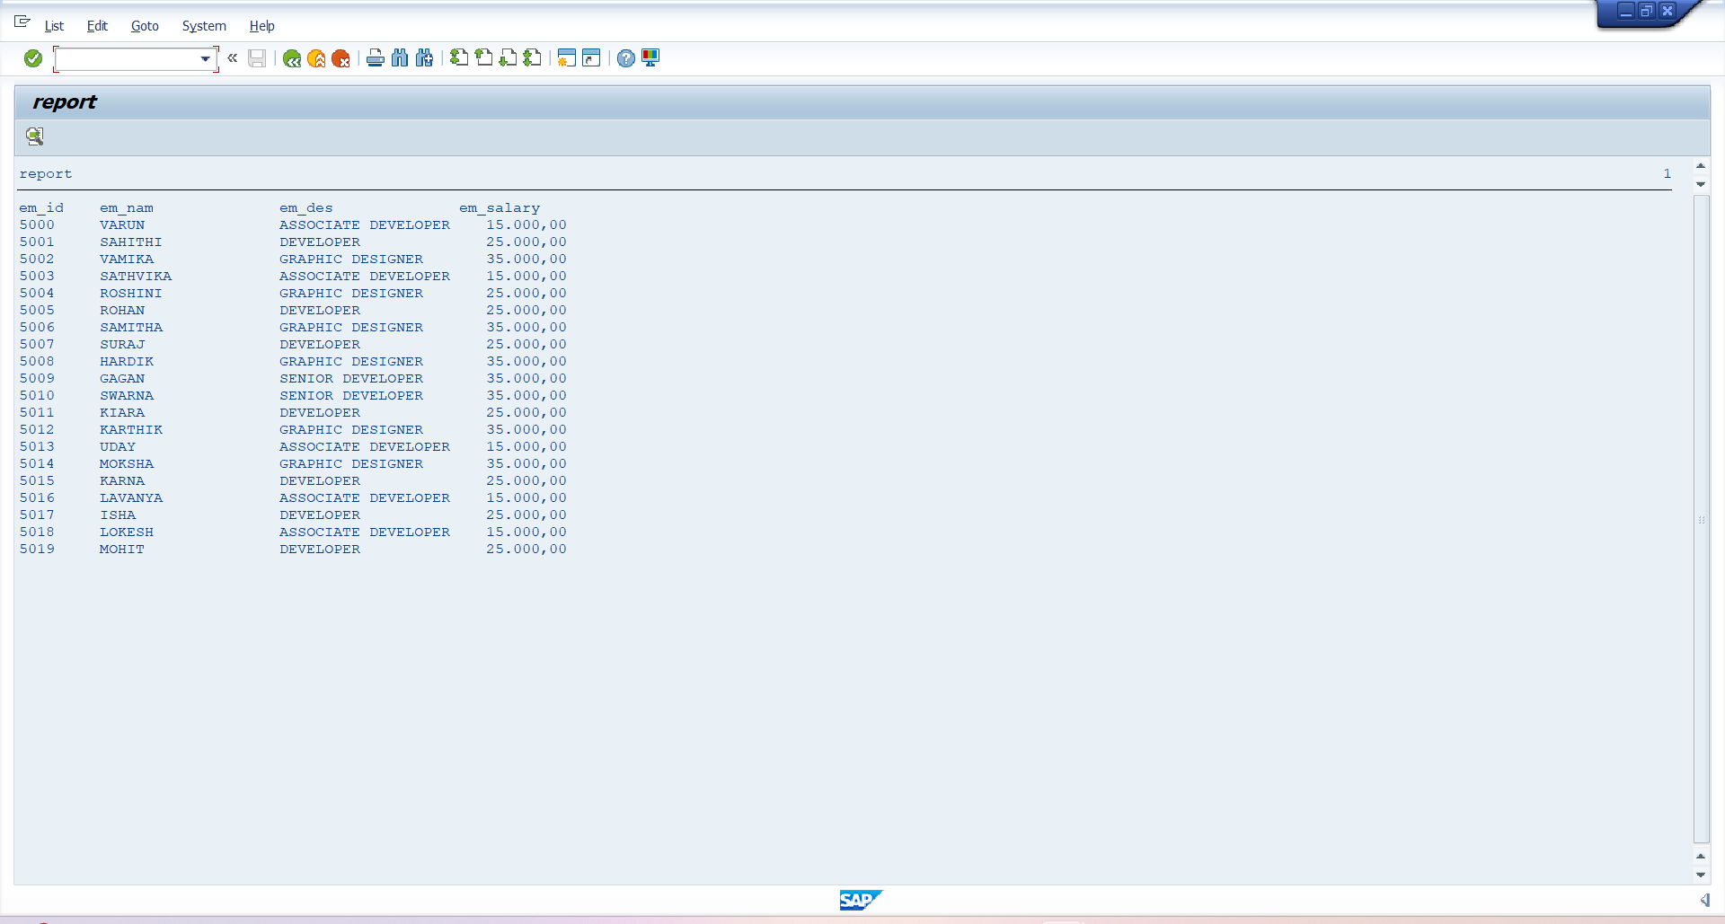
Employee data

Slide 12
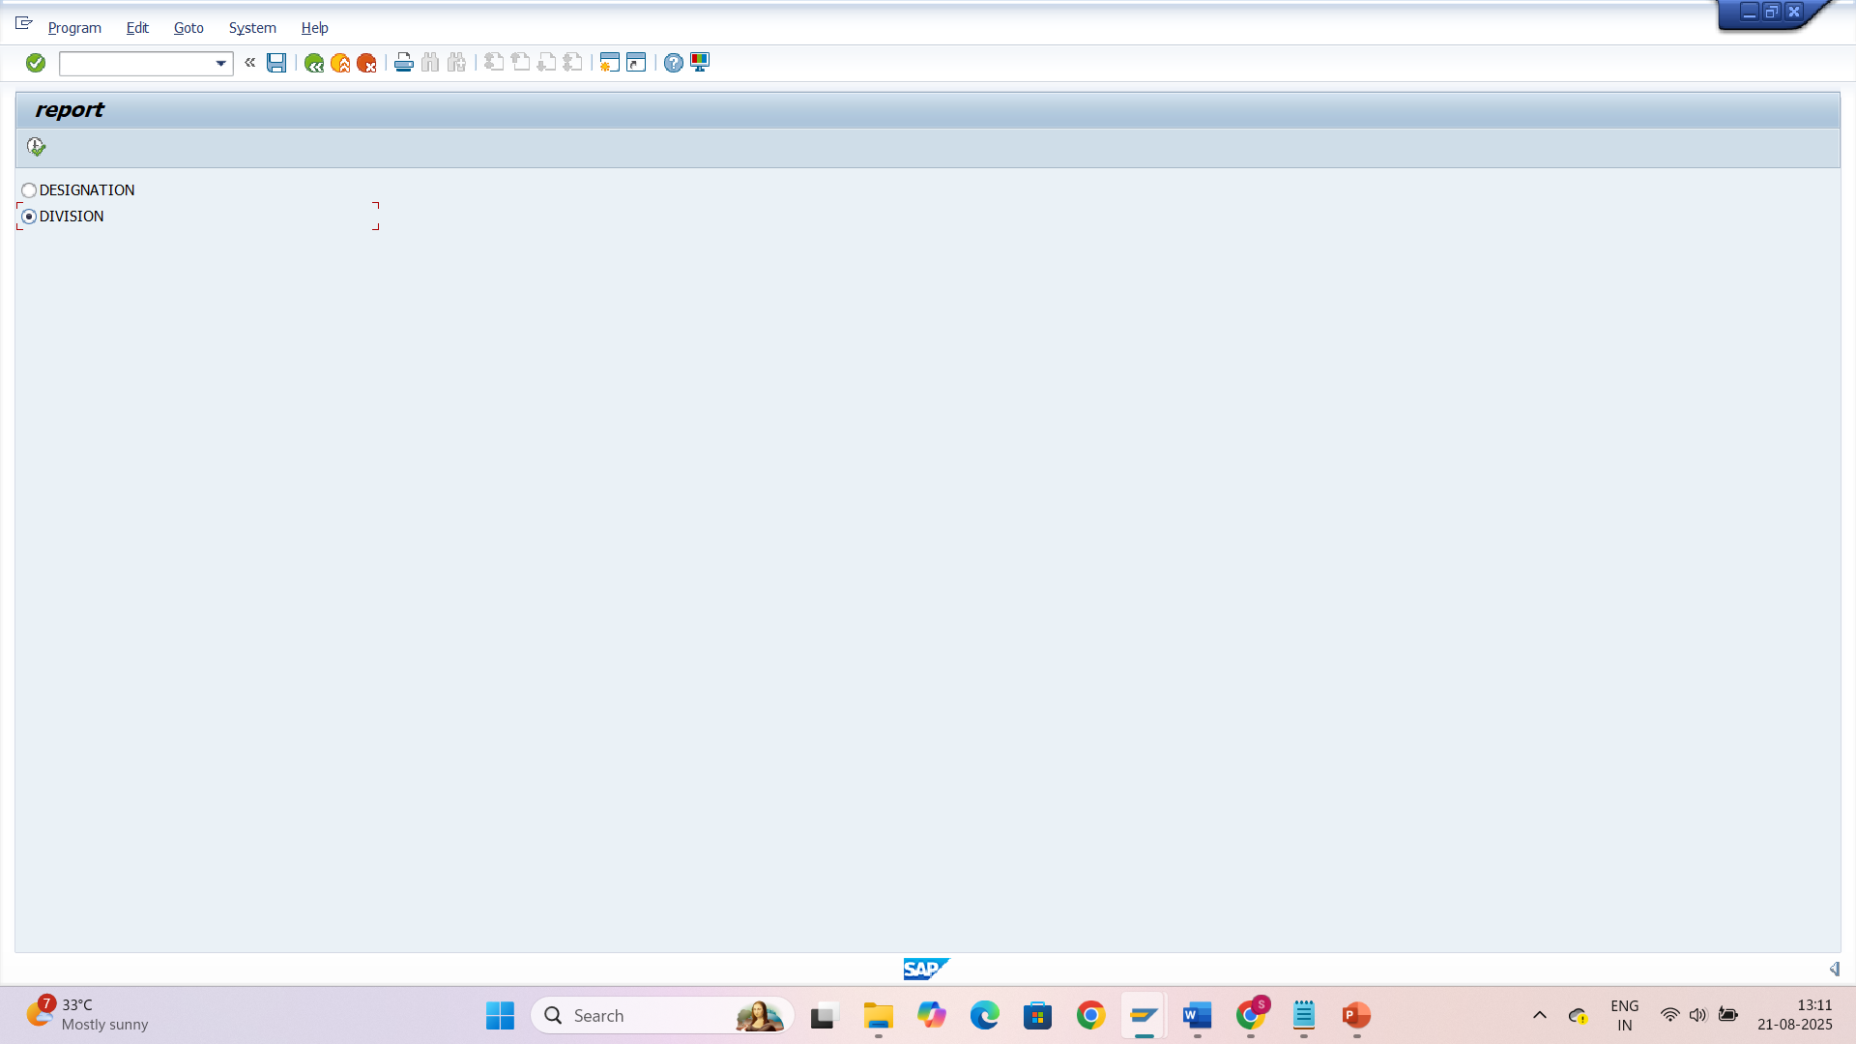
Output- Student data

Slide 13
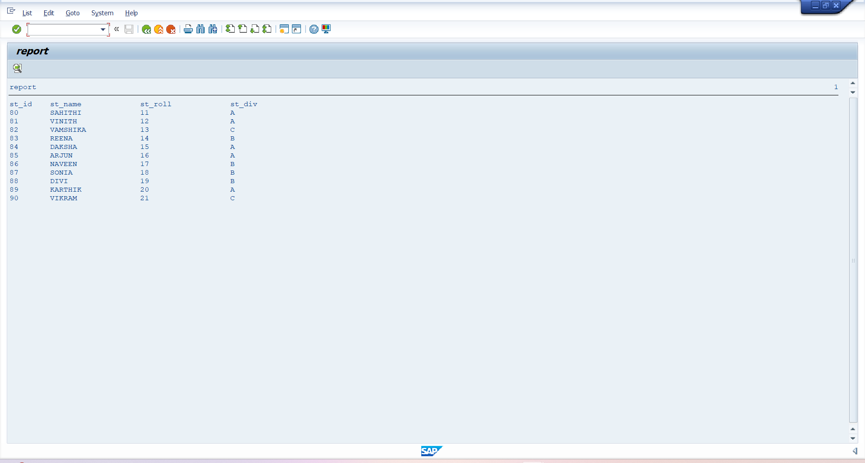
Student data

Slide 14
Project 3: ALV Report with Excel Download
Objective
To display student data in an ALV report.
Provide functionality to download the report into Excel file.
Allow the user to choose the file path and name dynamically.

Slide 15
technique
Selection Screen Parameter → File name input (p_fname) with F4 help (F4_FILENAME).
ALV Display → Using CL_SALV_TABLE=>FACTORY.
Convert ALV to XML → LO_ALV->TO_XML.
Convert XML to Binary → Function Module SCMS_XSTRING_TO_BINARY.
Download to Excel → Function Module GUI_DOWNLOAD with file type = 'BIN'.

Slide 16
steps
Create program in SE38.
Define file name parameter (p_fname) with F4 help for path selection.
Fetch data from custom table ZSTUDENT.
Generate ALV output using CL_SALV_TABLE.
Convert ALV output to XML format.
Use GUI_DOWNLOAD to save the file in given path.
Display success/failure message.
Also print report on screen with WRITE statements.

Slide 17
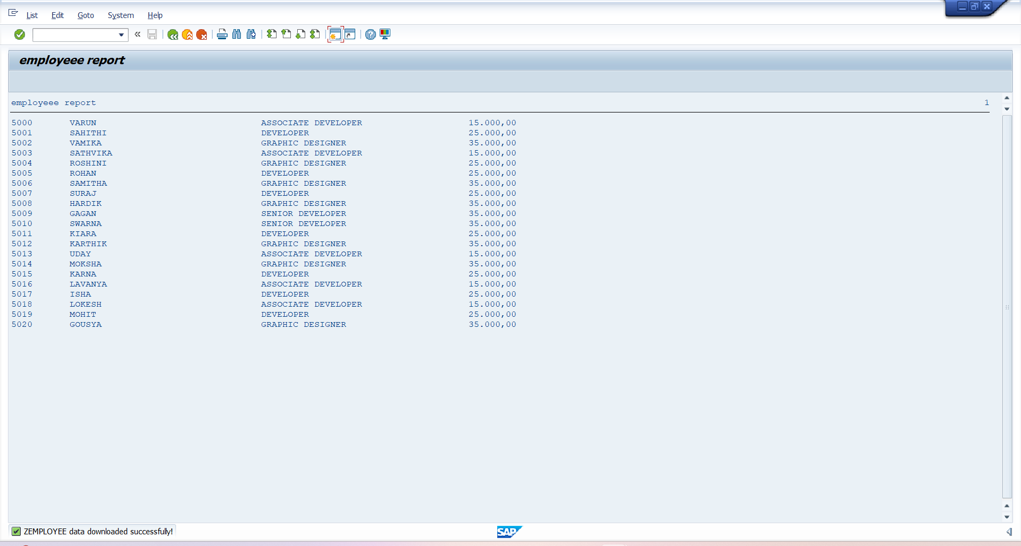
EMPLOYEE ALV REPORT

Slide 18
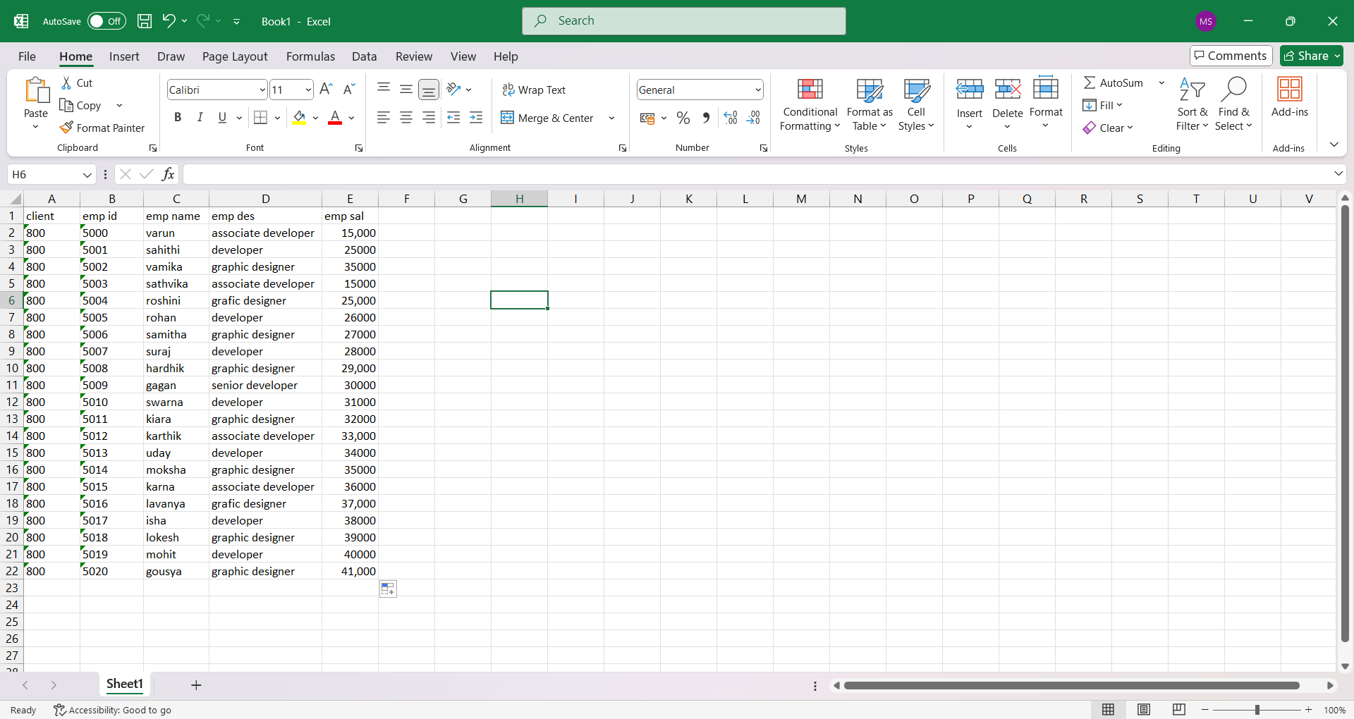
Employee data

Slide 19
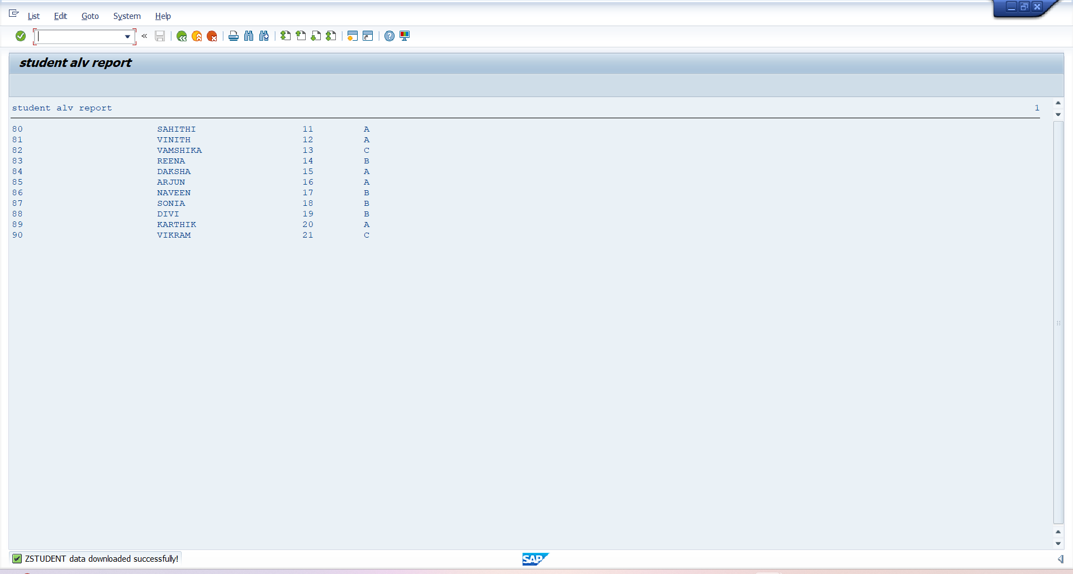
Student ALV Report

Slide 20
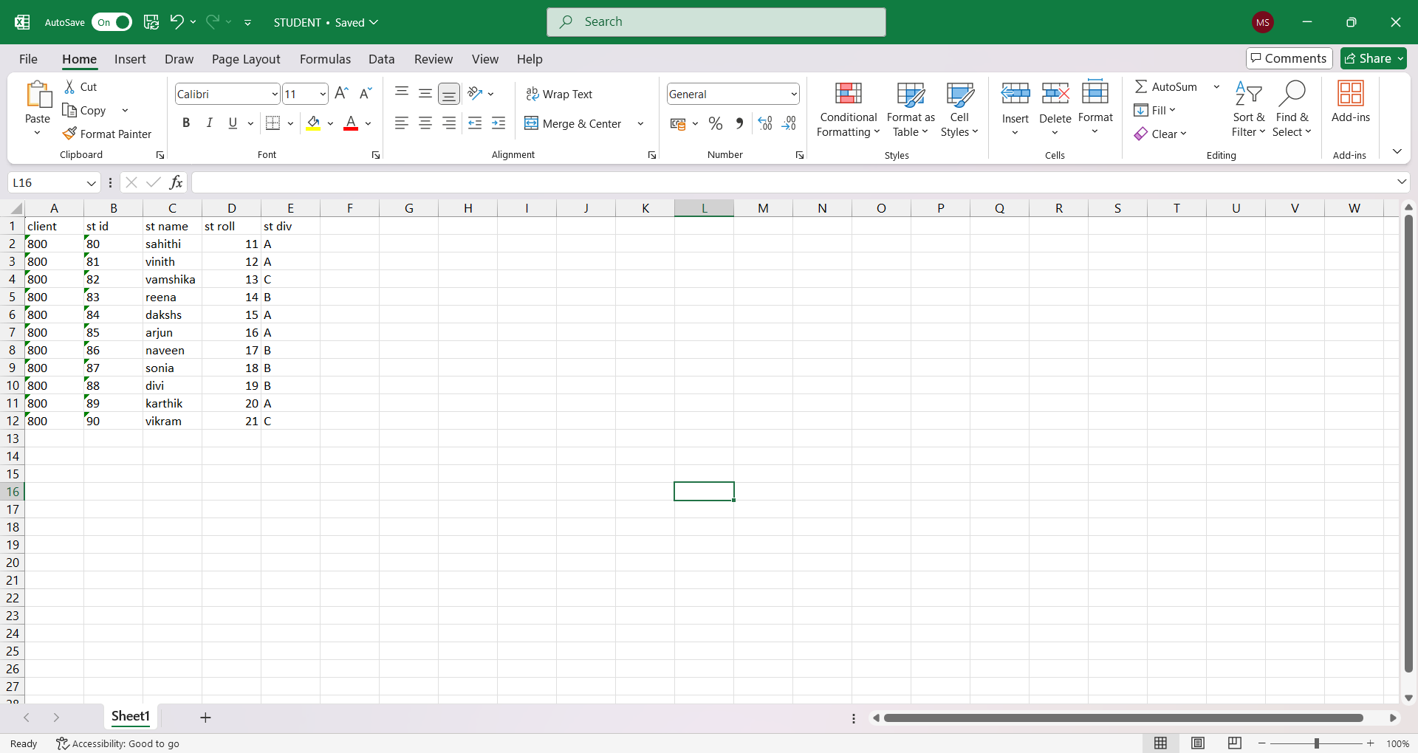
Student data

Slide 21
Project 4: Smart Forms
Objective
To design two Smart Forms:
Employee Data Smart Form
Student Data Smart Form
Add:
Logo
Address (on left)
Page numbers
Tabular format for data

Slide 22
Employee data smart form
Tables used:
ZSA_PRO1 – Employee table
Create program in se38
Declare structures , internal tables and work areas
Data retrieval via SELECT statements
Mapping fields to Smart form nodes
Execution
Smart form is called using Function Module
Integrated with ABAP program (SE38)
Sample ABAP code snippet for CALL FUNCTION

Slide 23
Technical Design
Features:
Company Logo (top-right)
Employee address (left side)
Employee details table (Name, ID, Designation, Salary)
Page number (bottom)
Smart Form Components
Create program in tcode - smart forms
Form Interface – Input parameters (Employee ID, employee name, designation and salary )
Global Definitions – Variables, structures
Main Window – Table output of data
Secondary Windows – Logo, Address, Page Number

Slide 24
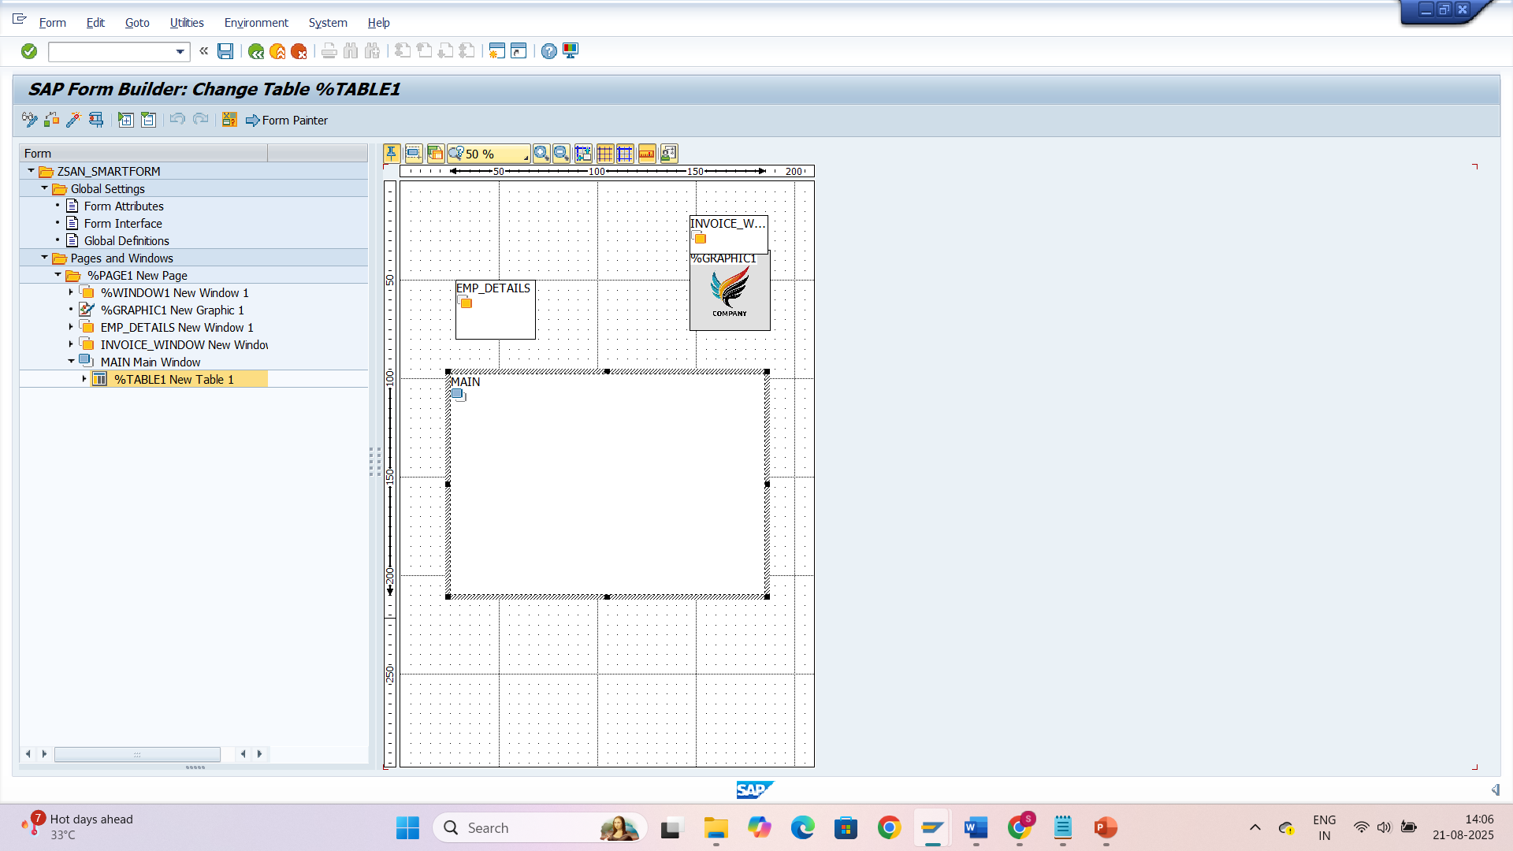
Employee smart form layout

Slide 25
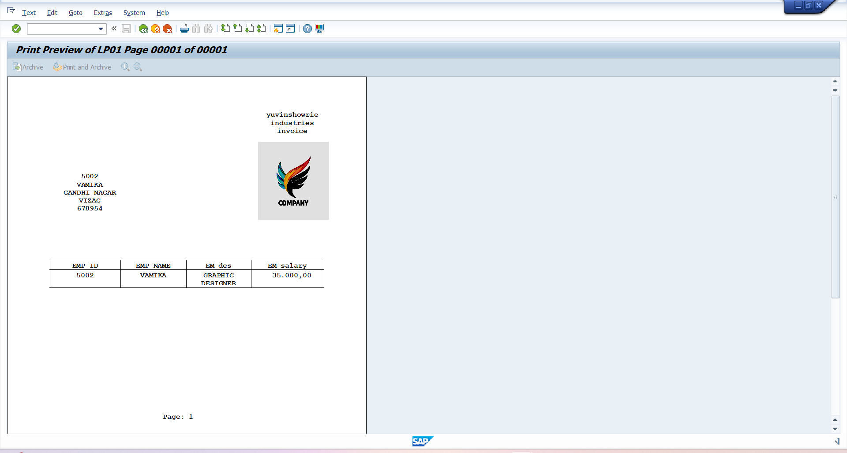
Employee smart form

Slide 26
Student data smart form
Tables used:
ZSAHI_MA – student table
Create program in se38
Declare structures , internal tables and work areas
Data retrieval via SELECT statements
Mapping fields to Smart form nodes
Execution
Smart form is called using Function Module
Integrated with ABAP program (SE38)
Sample ABAP code snippet for CALL FUNCTION

Slide 27
Technical Design
Features:
Institution Logo (top-right)
student address (left side)
student details table (Name, ID, roll,division)
Page number (bottom)
Smart Form Components
Create program in tcode - smart forms
Form Interface – Input parameters (Employee ID, employee name, designation and salary )
Global Definitions – Variables, structures
Main Window – Table output of data
Secondary Windows – Logo, Address, Page Number

Slide 28
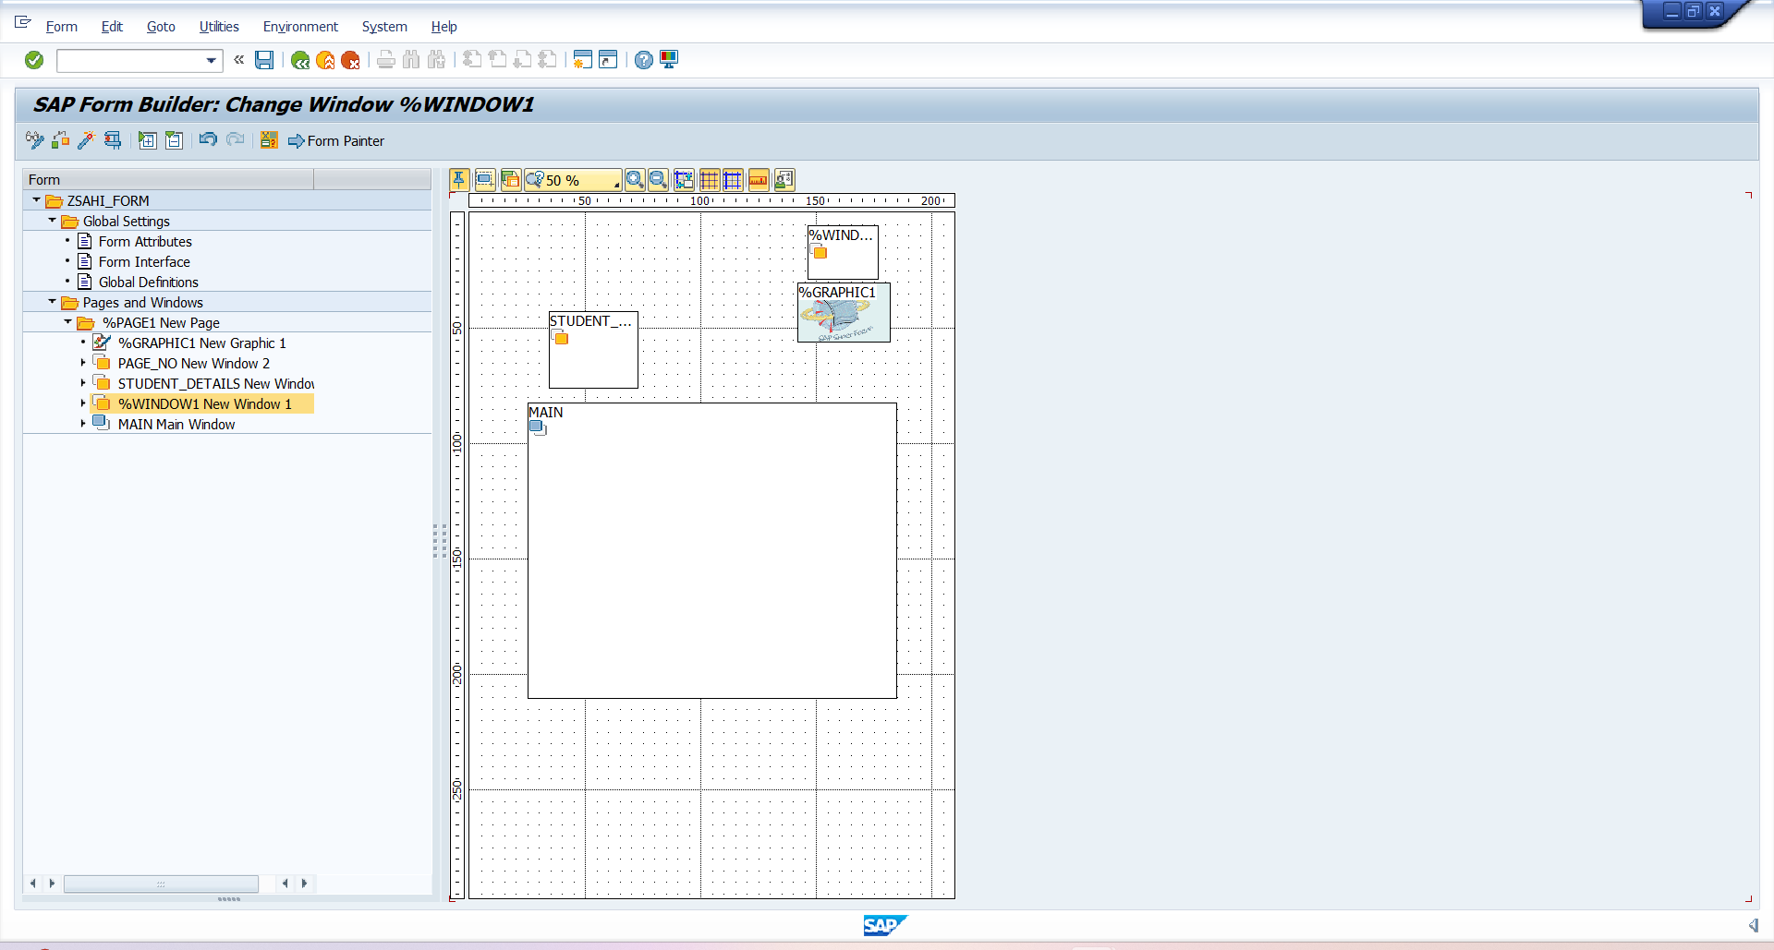
Student smart form layout

Slide 29
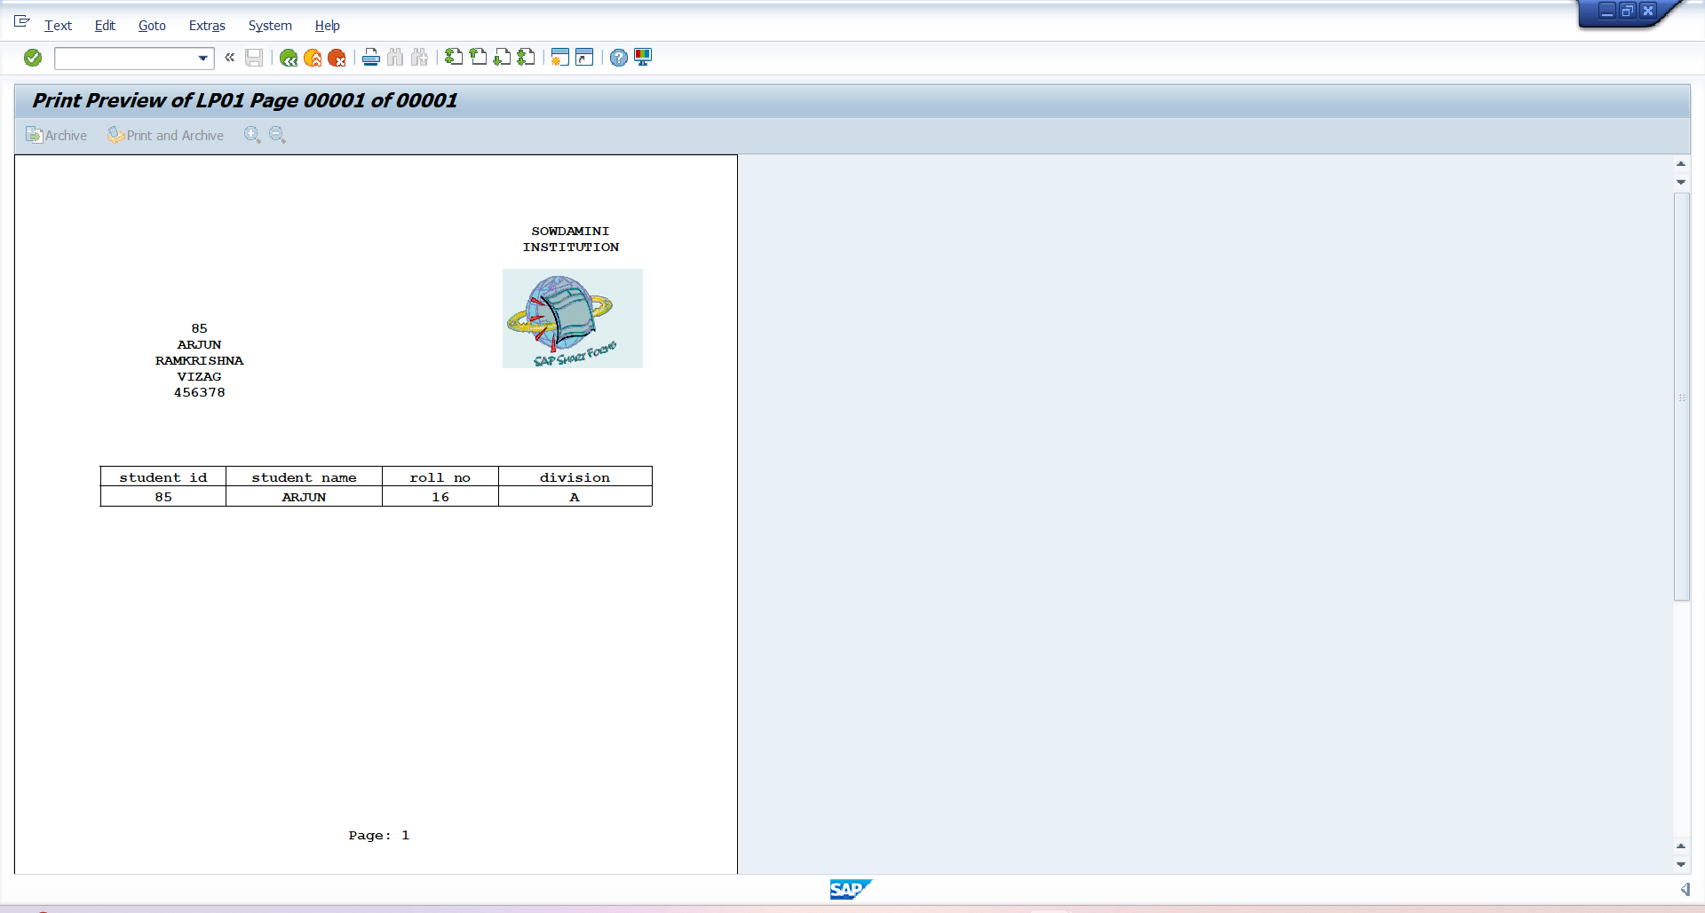
Student smart form

Slide 30
Project 5: Module Pool Program
Objective
To design a Module Pool Program (Dialog Programming) that allows navigation to different functionalities using radio buttons on the first screen.
Screen Design (Screen 100)
Screen contains 4 radio buttons:
Employee details report
Employee details update (Screen)
Student details report
Student details update (Screen)
Create Submit Button is provided to confirm selection.

Slide 31
FLOW/WORKING
When user runs the transaction Z_PROJECTMODULE, Screen 100 is displayed.
User selects one of the 4 radio buttons.
Based on selection:
Employee Report → Calls report program or ALV for Employee table
Employee Update → Navigates to an update screen (Screen 200)
Student Report → Calls report program or ALV for Student table
Student Update → Navigates to an update screen (Screen 300)

Slide 32
TECHNICAL DESIGN
Create Module Pool program in SE38.
Screens:
Screen 100 → Radio buttons (Selection screen).
Screen 200 → Employee Update Screen.
Screen 300 → Student Update Screen.
Tables Used:
ZSA_PRO1 – Employee Table
ZSA_TAB2 – Student Table

Slide 33
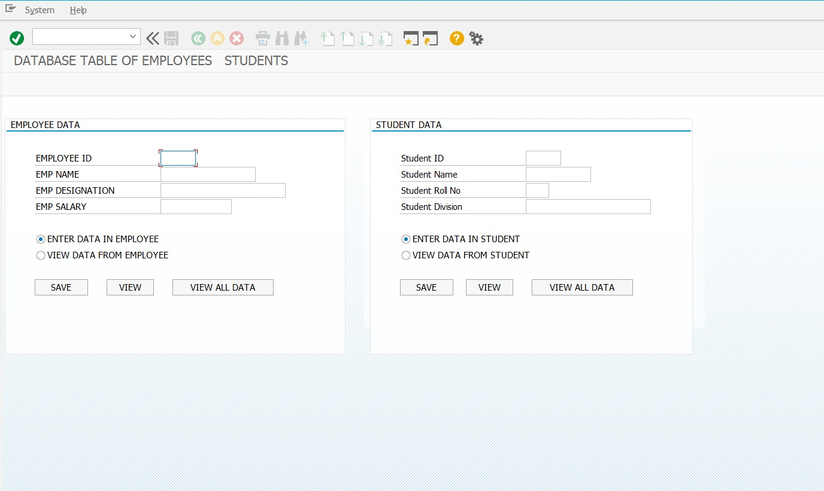
screen

Slide 34
Thank you

